Slide 1
Data Driven framework in Automation
SAROWER AHMMED

Slide 2
What data driven framework?
Framework which can handle testing data

Slide 3
For interview : My Current Framework
My current framework is data driver with BDD approach
I built my framework from scratch
It can validate data easily from
Application data
Web table
Chart
Dropdown
With
Excel data
Database data
But manually it’s a very hard job to calculate all data

Slide 4
My Current Framework has
Generic Library = all code with methods
PageFactory = all xpath inside and its act like a repo
Utility package = all util methods inside like highlight, screenshot
DB utitlty package = database connection with other methods to get value from database
Excel utitlty package = to handle excel with Apache POI
For Cucumber :
Feature file
Step def
Runner file

Slide 5
My Current Framework
I execute my code when application in ready and stable
I push my code into GitHub and connect with Jenkins for CI
I checked my build from maven or Jenkins
Also generate report with the help of TestNG and share reports with my team member

Slide 6
What are the test data source?
Data can be in-
Database- JDBC
Excel table-Apache POI
CSV format- Java
Jason- API testing/java in Eclipse
XML- Web service testing/java-Eclipse
All those data need to read in automation and match with application

Slide 7
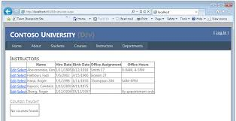




Why we need it?
Application data ==need to match ===➔ test data

Slide 8
How data remain in application?
Web Table
Drop down menu
Box
Bar chart
Graphs
Identify by xpath as String or list

Slide 9
String & List in Selenium Web Element
How to get data in java String from xpath?
String a= driver.findElement(By.Xpath(“xpath”)).getText();
List<WebElement> AllName= driver.findElements(By.Xpath(“xpath”)).
For(int i=0;i<Allname.size;i++){
String b=Allname.get(i).getText();
}

Slide 10
Tag Description: Web Table
<table> Defines a table
<th> Defines a header cell in a table
<tr> Defines a row in a table
<td> Defines a cell in a table
<tbody> Groups the body content in a table
Create xpath with those tag and add your value in List
List<WebElement> column= driver.findElements(By.Xpath(“./table/tr/td[1]”)).
For(int i=0;i< column.size;i++){
String b=column.get(i).getText();
}

Slide 11


Excel Automation with Apache POI
Sarower Ahmmed

Slide 12
Why need excel in automation?
To handle test data
To do all manual data driven testing
Can generate graph or any report for automation
Can do advance data calculation and report

Slide 13
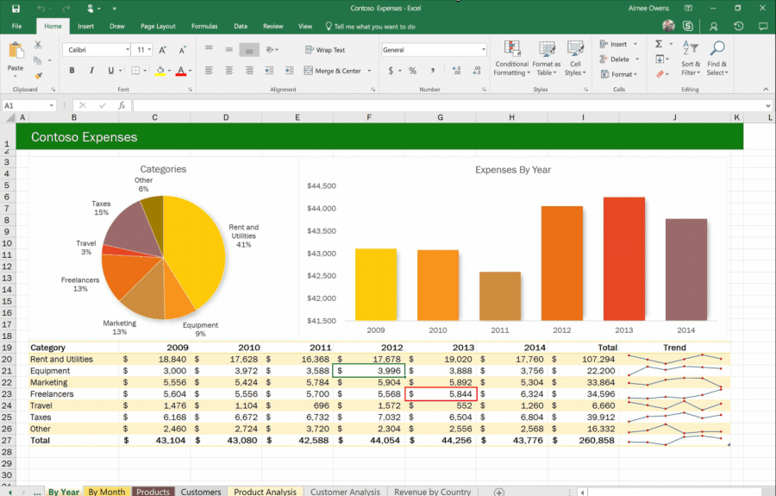

Slide 14
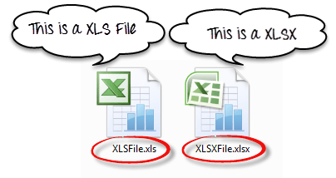
HSSF= 2007+ excel version HSSF= before 2007 old version

Slide 15
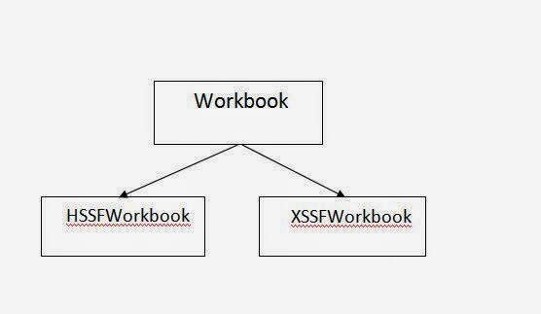
Whole excel= workbook

Slide 16
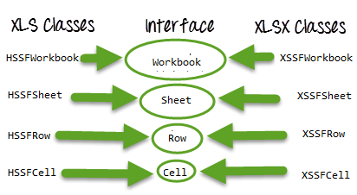

Slide 17
POM.xml
Apache POI library or JAR file for pom
<dependency>
<groupId>org.apache.poi</groupId>
<artifactId>poi</artifactId>
<version>3.17</version>
</dependency>
<dependency>
<groupId>org.apache.poi</groupId>
<artifactId>poi-ooxml</artifactId>
<version>3.17</version>
</dependency>

Slide 18
How to find excel file?
By java sterilization method fileinputsteam()
File file = new file(“excel path”)
Fileinputsteam fs= new Fileinputsteam(file);

Slide 19
Parts of a excel document
Whole excel file known as ➔ workbook
Excel sheet known as ➔ worksheet
Excel row known as➔ row
Excel column/ cell known as➔ cell

Slide 20
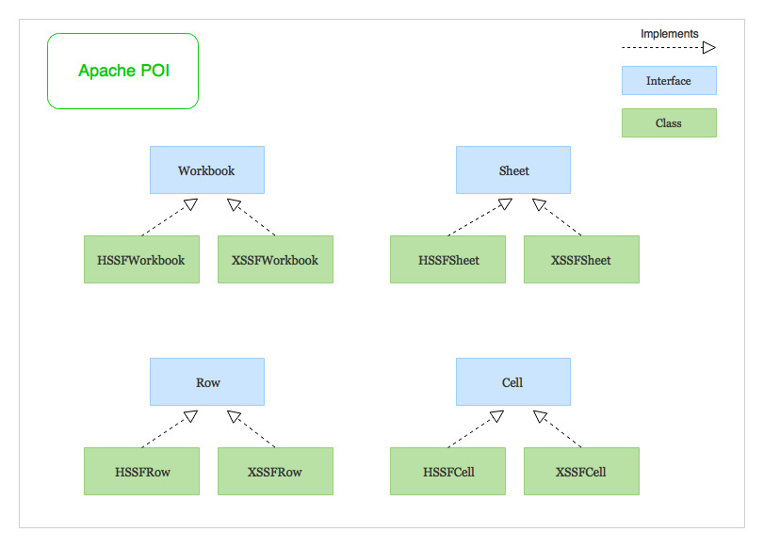

Slide 21
Code for Read excel HSSF(part one)
File file = new file(“excel path”)
Fileinputsteam fs= new Fileinputsteam(file);
HSSFWorkbook wb= new HSSFWorkbook(fs);
HSSFWorksheet sheet= wb.getsheetat(number of your sheet)
Or HSSFWorksheet sheet= wb.getsheet (“your sheet name”)

Slide 22
Row and cell(add part one + below code)=HSSF(old excel)
int rowNum = ws.getLastRowNum()+1;
int colNum = ws.getRow(0).getLastCellNum();
String[][] data = new String[rowNum][colNum];
for (int i=0; i<rowNum; i++){
HSSFRow row = ws.getRow(i);
for (int j=0; j<colNum; j++){
HSSFCell cell = row.getCell(j);
String value = cellToString(cell);
data[i][j] = value;
System.out.println("The value is" + value);
}
}
}

Slide 23
XSSF code>> new excel(Part one)
public static ArrayList<String> columnValue(String path,int columnNumber) throws Throwable
{
FileInputStream file= new FileInputStream(path);
HSSFWorkbook workbook=new HSSFWorkbook(file);
HSSFSheet sheet= workbook.getSheetAt(0);
ArrayList<String> columnValue= new ArrayList<String>();
int RowCount= sheet.getPhysicalNumberOfRows();
System.out.println("Total Rows Number::"+ RowCount);
for(int rowindex=1;rowindex<RowCount;rowindex++) {

Slide 24
Part two: XSSF
Row row=sheet.getRow(rowindex);
//System.out.println("Total Column Number::"+ row.getPhysicalNumberOfCells());
if (row!=null) {
for(int colmindex=0;colmindex<row.getLastCellNum();colmindex++) {
if(colmindex==columnNumber) {
Cell cell=row.getCell(colmindex);
if(cell!=null) {
DataFormatter df= new DataFormatter();
columnValue.add(df.formatCellValue(cell));
}}}}}
return columnValue;

Slide 25
How to write excel?
Use java deserilization method➔ fileoutputsteam
FileOutputStream fileOut = new FileOutputStream(“destination path");
workbook.write(fileOut);
fileOut.close();
// Closing the workbook
workbook.close();

Slide 26
How to get a specific cell?
To get value from cell ➔
Row.getcell(cell number)
To create new cell in excel➔
row.createCell(0).setCellValue(“sarower”)

Slide 27
How to get all rows or all cells
int rowNum = ws.getLastRowNum();
int colNum = ws.getRow(rownumber).getLastCellNum();
Or
int colNum = row.getLastCellNum();

Slide 28
Where to store excel value?
Use java collection class
We use ➔
List
Array
ArrayList
Map== hashmap
Which one you use in your work?
List/ArryList or Hashmap

Slide 29
DB connection
Class.forName("oracle.jdbc.driver.OracleDriver");
Connection connection = DriverManager.getConnection("jdbc:oracle:thin:@localhost:1522/orcl", “user", “pass");
PreparedStatement preparedStatement = connection.prepareStatement(query);
ResultSet rs = preparedStatement.executeQuery();

Slide 30
How to read column data from data base?
PreparedStatement preparedStatement = connection.prepareStatement(query);
ResultSet rs = preparedStatement.executeQuery();
ArrayList<String> columnValue = new ArrayList<String>();
while(rs.next())
{
columnValue.add( rs.getString(columnName));
}
connection.close();
return columnValue;
}

Slide 31

How to read data from notepad?
Create a folder and a file like below in project
Copy code inside file
URL=https://www.UPS.com/
userName= Student@gmail.com
pass=student

Slide 32
Write these code in java(Part one)
public class configDataProvider {
Properties pro;
WebDriver driver;
public configDataProvider (){
File src = new File("./Configuration/config. properties");
try {
FileInputStream fis =new FileInputStream(src);
pro = new Properties();
pro.load(fis);
} catch (Exception e) {
System.out.println("Exception is"+e.getMessage());
}
}

Slide 33
Part Two
public String getApplicationURL(){
String url=pro.getProperty("URL");
return url;
}
public String getUsername(){
String url=pro.getProperty("userName");
return url;
}
public String getPass(){
String url=pro.getProperty(" pass");
return url;
}

Slide 34
Read data from CSV file:
List<String> allData=new ArrayList<>();
BufferReader csvfile = new BufferReadrer(new FileReader(File));
String dataRow= csvfile.readLine();
While(data != null){
String [] dataArray =dataRow.split(“,”);
for(String data: dataArray){
allData.add(data);
}
dataRow=csvfile.readLine();
}
Syso(alldata)

Slide 35
How to read Json
We can read JSON file with
JAVA
Also API testing

